Slide 1


Process for uploading Investments proofs on the online tool for FY 2014-15
Internal
SAP – Global Payroll
January 2015

Slide 2
Features of online tool :
  The on-line tool will help you to update your proposed Investment plan and actual investment proof submission for the Financial Year 2014-2015
  You need to upload the Actual Investment Proofs after updating in the system by using the Link.
  Medical ,Telephone ,LTA bills and other claims needs to be submitted along with the claim form as and when the employee incurs the expenditure after updating the link
  Rent receipts needs to be submitted in hard copy
  It also help you to know the current status of your claims on-line (i.e. whether its under process or accepted or rejected for clarification, etc)

Slide 3
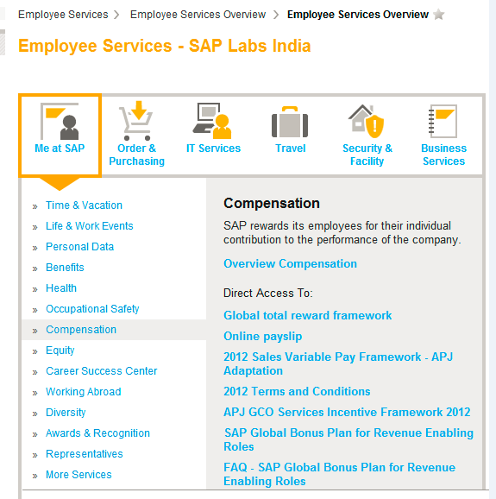
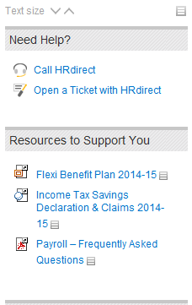
How to Access the Link?

Slide 4
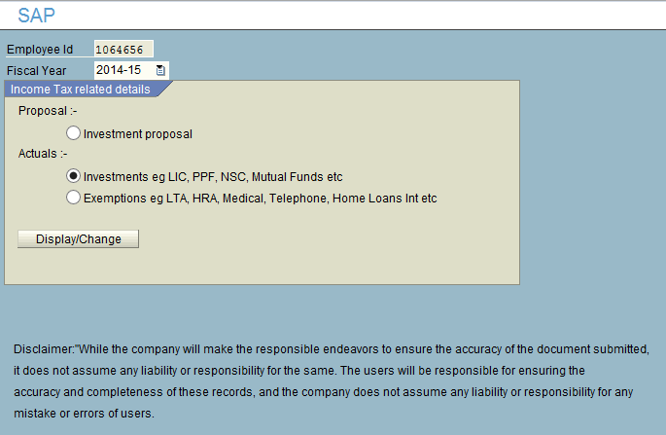
Documents Submitting Process :
Step 1
Click on the Investment actuals.
Step 2
Click on Display / Change Button
(this will take you to next step)

Slide 5
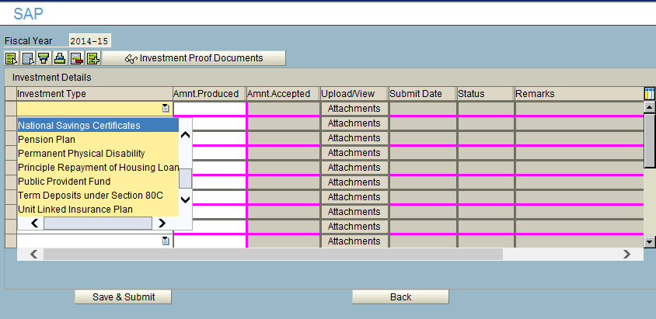
Documents Submitting Process :
Step 3 :
Select the type of investment under
which you would like to upload
Step 5 :
Click on the attachments for uploading
Step 4 :
Enter the correct amount

Slide 6
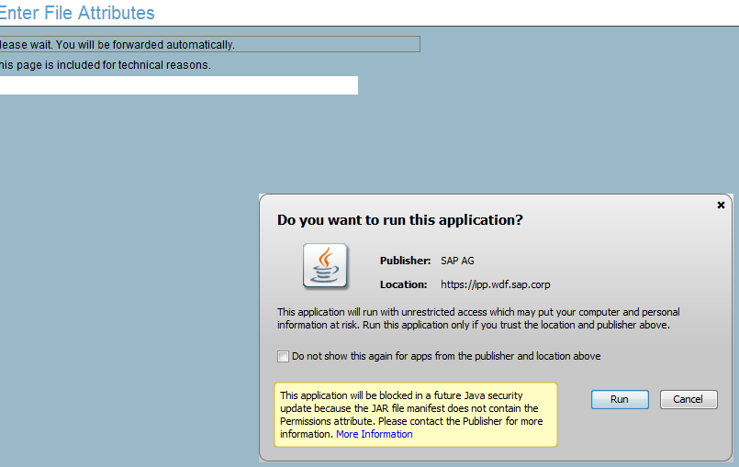
Documents Submitting Process :
Step 6 :
Click on run button to enable the application

Slide 7
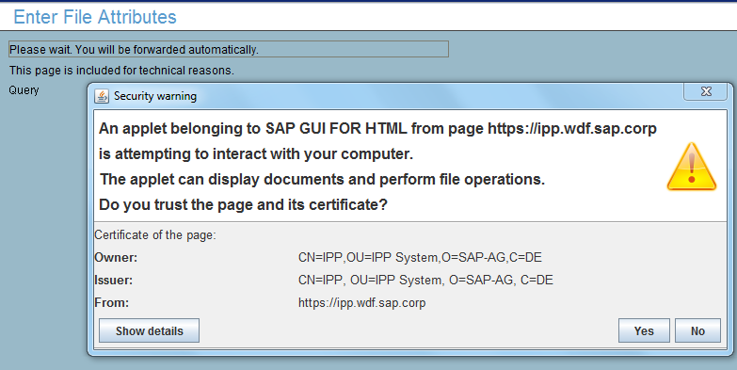
Documents Submitting Process :
Step 7 :
Click on Yes button to enable the application only for the first time

Slide 8
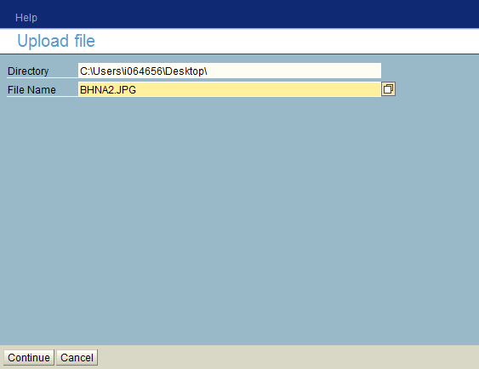
Documents Submitting Process :
Step 8 :
Select the file from the location you have saved
Step 9 :
Click on Continue
Note: Scan and save the related document on your Desktop. Multiple documents can be saved as one folder zip the file to upload

Slide 9
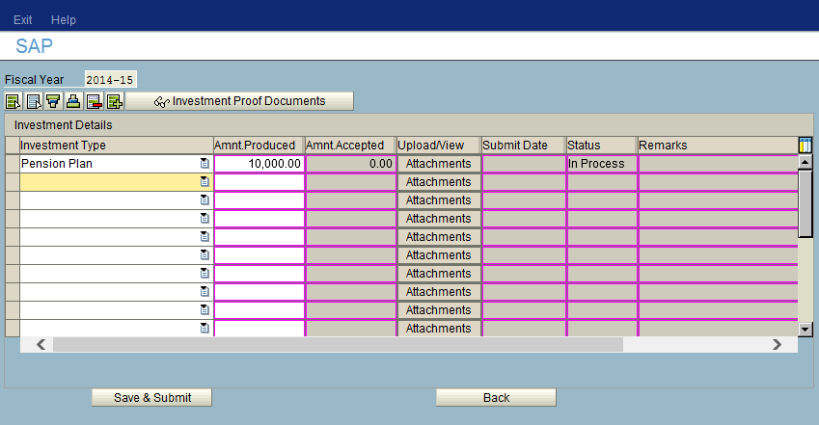
Documents Submitting Process :
Step 10 :
After uploading the investment proofs, click on “Save & Submit.”

Slide 10
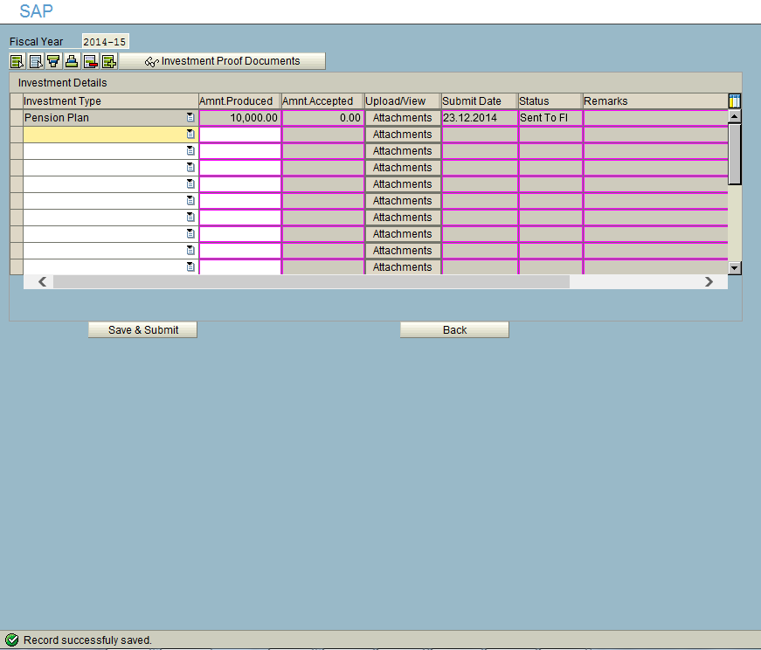
Documents Submitting Process :
Step 11 :
Check the status, must be “Sent to FI”
Step 12 :
Finally you must get a message for saving the documents.
NOTE :
If you have more than one receipts of the same investment type. Update the total amount in one line item and avoid multiple entries.

Slide 11
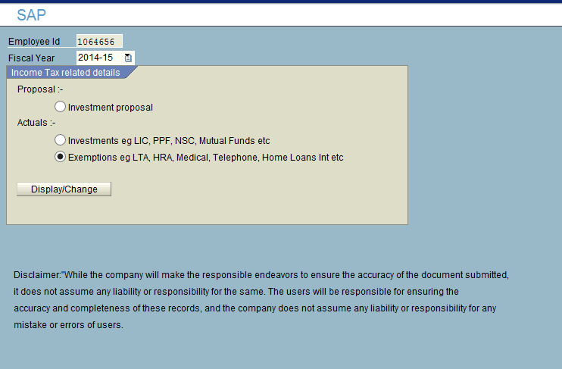
Submitting Rent, LTA, Telephone, Medical Bills and Home Loan Interest Proofs
Step 1 :
= Click On Exemptions,
= Click on Display / Change Button

Slide 12
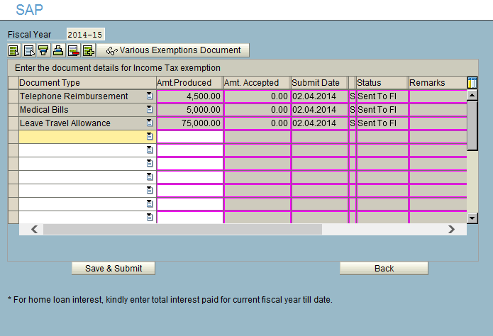
Submitting Rent, LTA, Telephone, Medical Bills and Home Loan Interest Proofs :
Step 2 :
Select the document type, Update the amount, Click Save & Submit, Check the status, must be “Sent to FI”
NOTE :
You need to update only the amount, except for Interest on Housing loan document must be attached along with the principle upload under investment.

Slide 13
Thank you
For assistance : e-mail to
SAP HRDirect APJ hrdirectapj@sap.com

